Slide 1
Variable Reflectivity Coatings for Optical Propulsion Applications
Joseph. N. Vlastos
Sydney.Taylor & Liping. Wang Ph.D
School of Matter and Transport, Assistant Professor

Slide 2
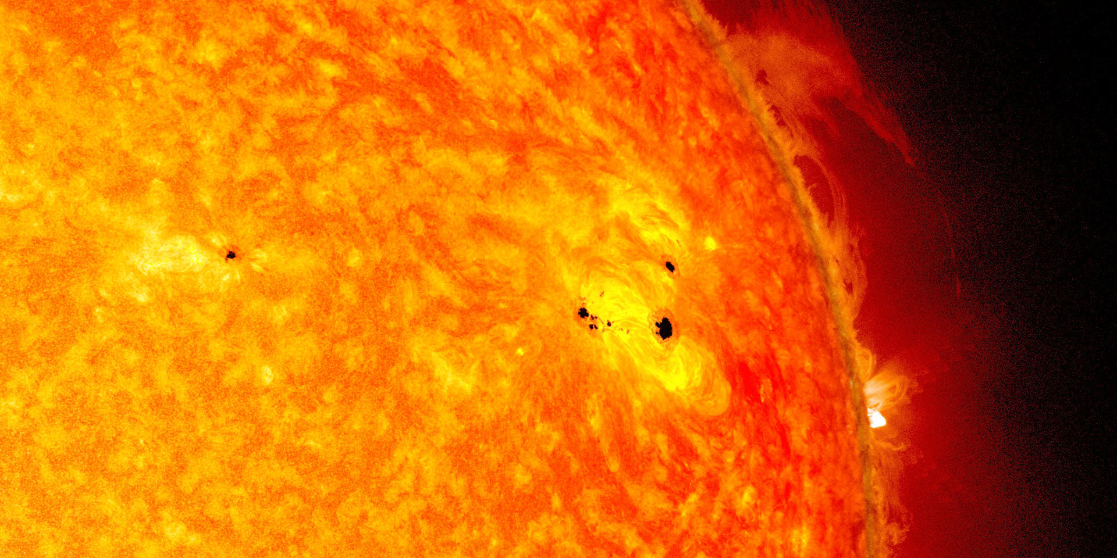

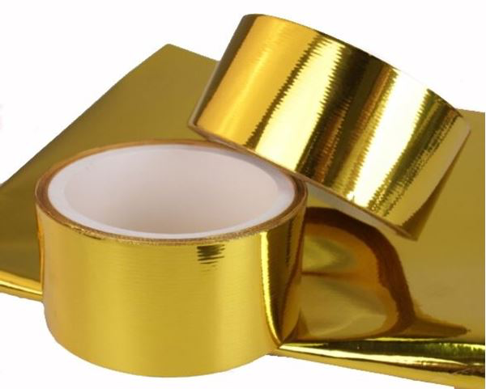
Solar Sailing
Facts
Uses solar radiation pressure
  Microscale propulsion
  Attitude control
Advantages
No need to bring fuel
Long lasting

Slide 3
Utilizing pressure difference
OFF
Solar Radiation
Pressure Force
Torque
Incident light
Absorption radiation pressure
=
½
Reflectance radiation pressure
Off State = Absorption
Perfectly black service
No reflection
Solar Radiation
Pressure Force
Incident light
ON
Reflected light
On State = Reflectance
Appears like a mirror
Reflects all wavelengths
No absorption
Differences in pressure causes torque
Attitude control

Slide 4
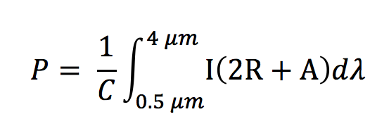
Radiation Pressure Equation
I = Solar extraterrestrial AM 1.5 Spectrum
R = Reflectance
A = Absorption
C = Speed of light
T = Transmittance
Opaque
0
A + R + T= 1
A = 1 - R
Notes:
me

Slide 5
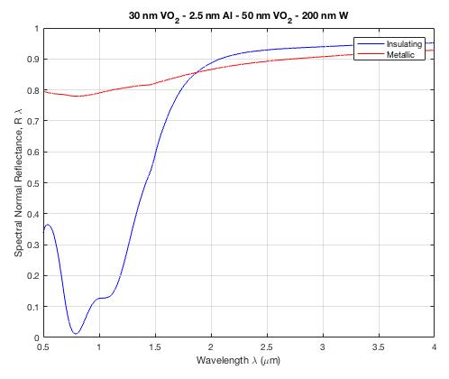
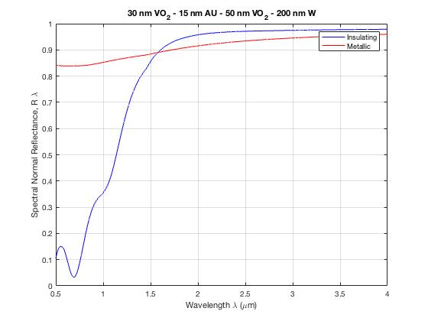
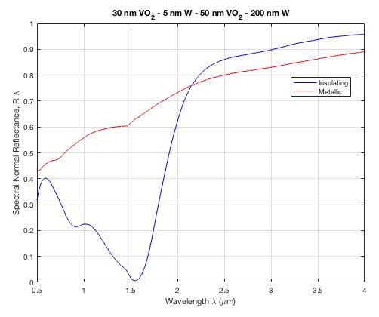
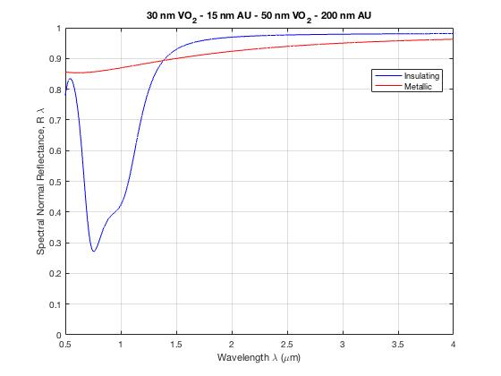
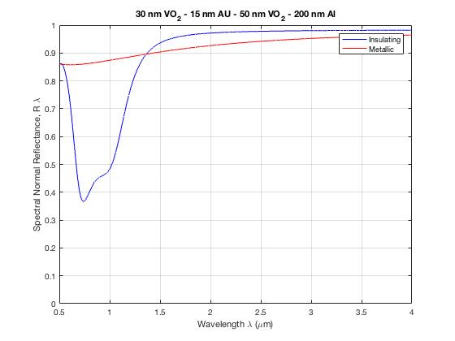
Results
Top mirror metals
Aluminum
Gold
Tungsten
Bottom mirror metal
Gold
Tungsten
Aluminum

Slide 6
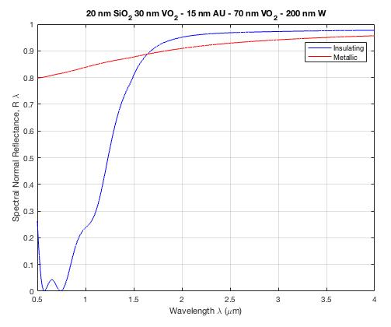
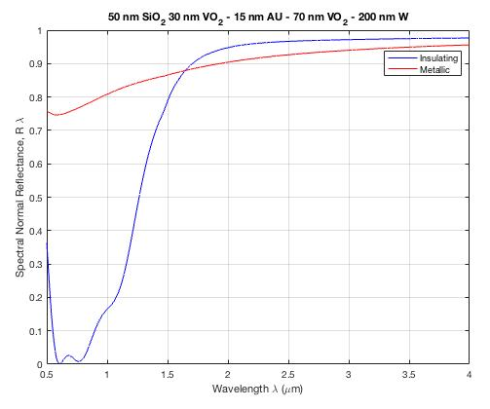
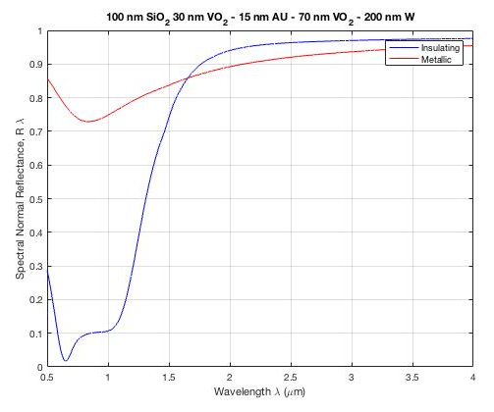
Results
Anti-Reflective coating SiO₂
20nm SiO₂
50nm SiO₂
100nm SiO₂
n_{i}= 1
Anti-Reflective coating SiO₂
Reflection
Anti-Reflective coating VO₂
2
Au film mirror
n₁ – n₂
Phase change spacer VO₂
R =
n₁ + n₂
Tungsten W mirror
0nm SiO₂
Silica wafer

Slide 7
Fabrication
  6) Anti-Reflective coating SiO₂ using Chemical Vapor Depositions
  5) VO₂ Using that same method
  Electron Beam Evaporation
  Furnace annealing to oxidize
  4) Au Gold via Electron Beam
3) VO₂
  Electron Beam Evaporation
  Furnace annealing to oxidize
2) Tungsten added via Sputtering
1) Starts with a Silica Wafer
Anti-Reflective coating 2 SiO₂
Anti-Reflective coating VO₂
Au film mirror
Phase change spacer VO₂
Tungsten W mirror
Silicon wafer

Slide 8
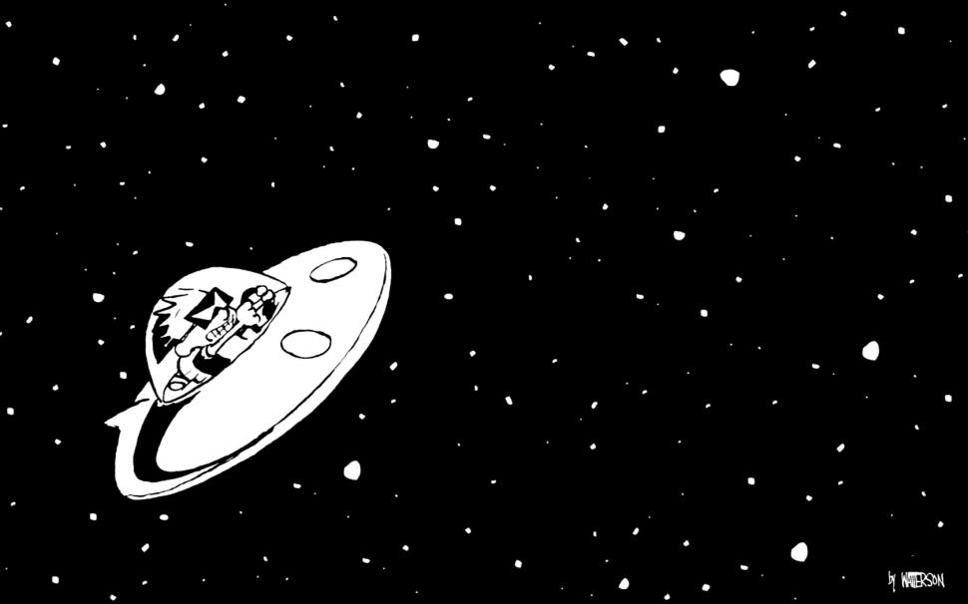
Future plans
Characterize the interaction between thermochromic and electrochromic responses
Verify model experimentally
Redesigns for electrical measurements

Slide 9


Acknowledgments
/ Space Grant
Liping. Wang Ph.D (Mentor)
Sydney Taylor
Desiree Crawl
Hassan Alshehri
My Audience for listening
References
Taylor, Sydney, and Liping Wang. “Vanadium Dioxide-Based Variable Reflectivity Radiation Coatings for Optical Propulsion Applications.” International Astronautical Congress, vol. 67, Sept. 2016.

